Slide 1
From Geometry to Startups — Rising of a New Robotic Industry in China
Zexiang Li
Automation Technology Center
Hong Kong University of Science and Technology

Slide 2
Table of Contents
Robotic problems of geometric nature
Geometers and “geometric” engineers
The unifying tool: Differentiable manifolds and Lie group theory
From geometry to startups
Opportunities and challenges of a new robotic industry in China
Conclusion

Slide 3
1. Robotic Problems of Geometric Nature

Slide 4
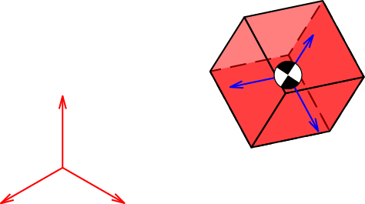

A. Rigid Body Motion
Kinematics
Trajectory generation
Dynamics
Stability
Control
…

Slide 5
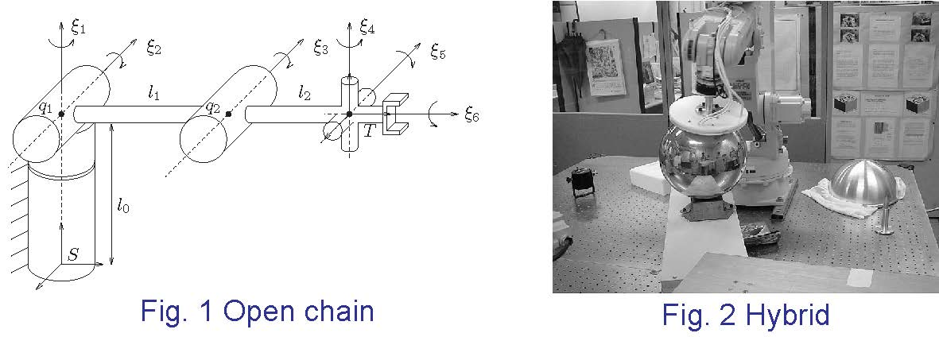
B. Robot Manipulators
Forward kinematics
Inverse kinematics
Jacobian
Open chain
Hybrid control
Dynamics
Control
…

Slide 6
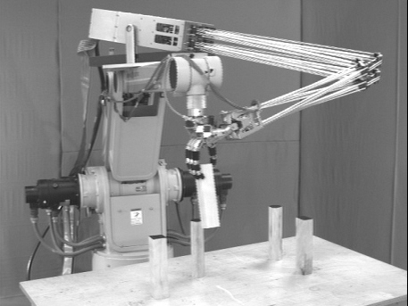
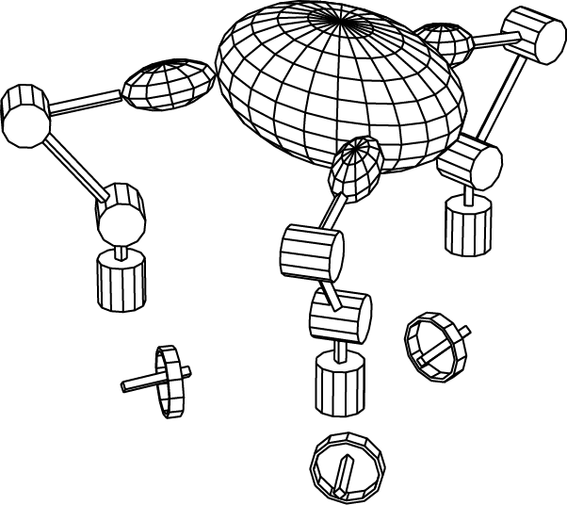
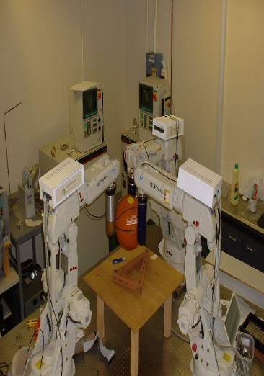
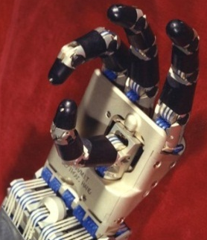
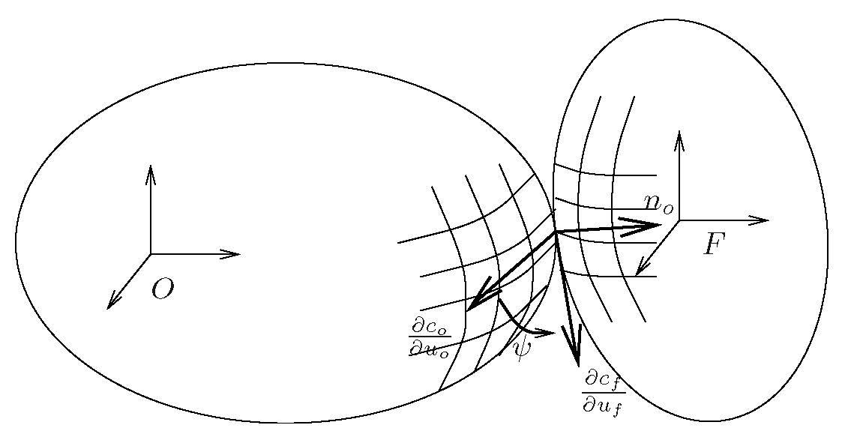
C. Robotic Hands
Grasp model
Force optimization
Kinematics of contact
…
Utah-MIT hand
HKUST hand
Kinematics of contact

Slide 7
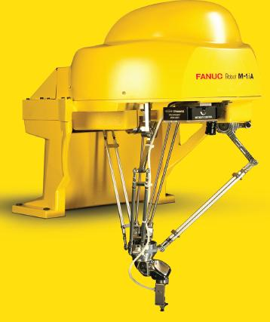
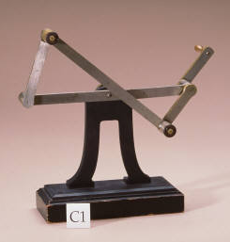
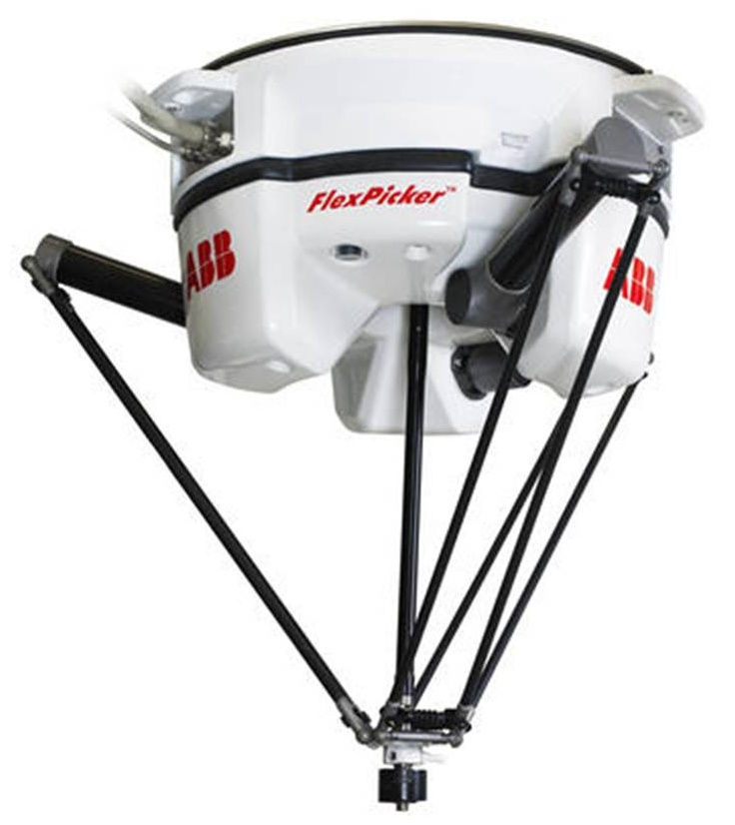
D. Parallel Mechanisms
Kinematic analysis
Dynamics and control
Synthesis
…
Four bar linkage
Delta robot
Fanuc 6-DoF parallel robot

Slide 8
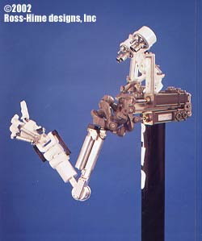
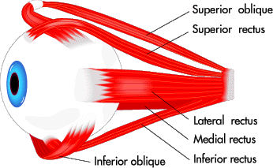
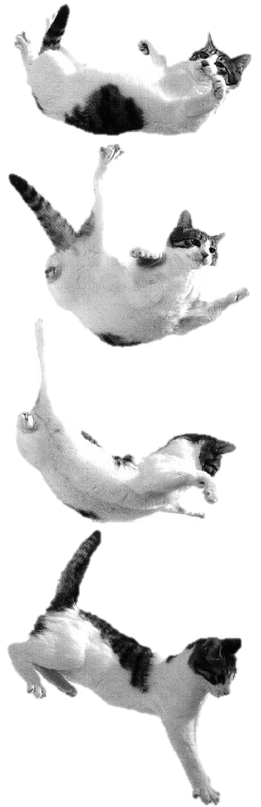
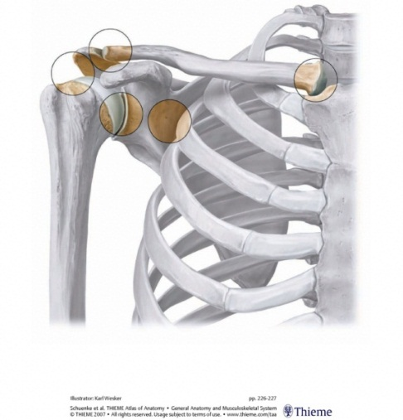
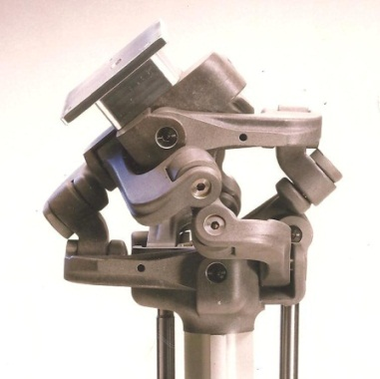
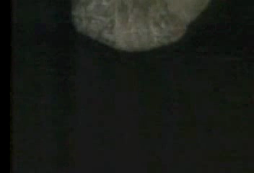
E. Biomechanics
AC joint
Clavicle
SC joint
GH joint
Scapula
Humerus
Human shoulder complex
Eye movement
Modeling
Analysis
Planning and control
Synthesis
…
Falling Cat

Slide 9
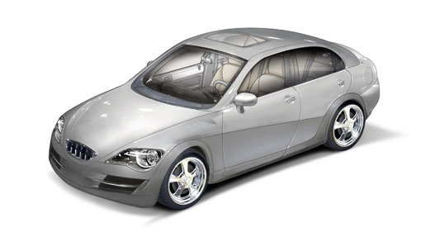
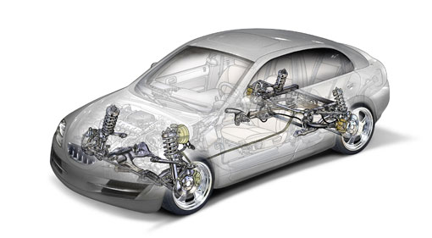
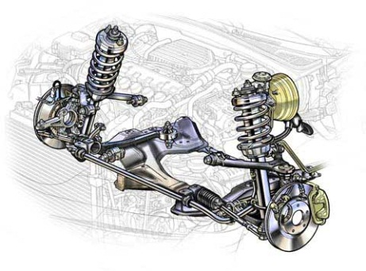
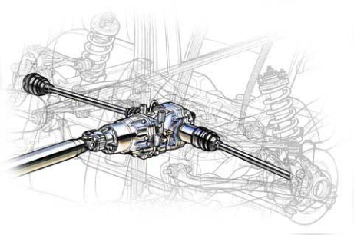
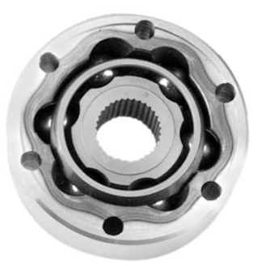
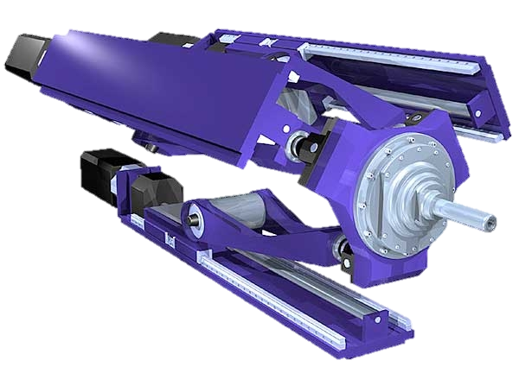
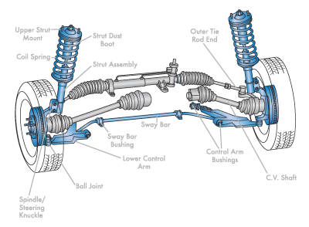
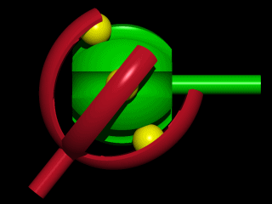
F. Machine Design
Sprint Z3 parallel module
Constant velocity joints
Rzeppa Joint (1929)
Modeling and analysis
Synthesis and design
…

Slide 10
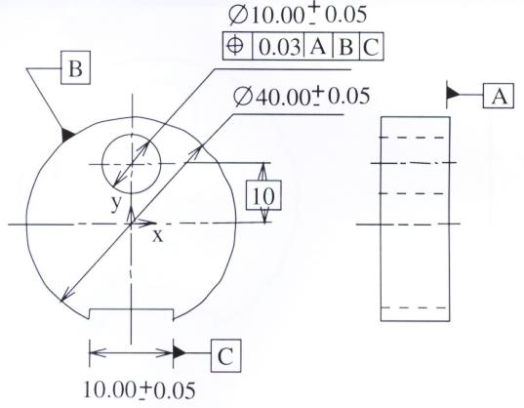
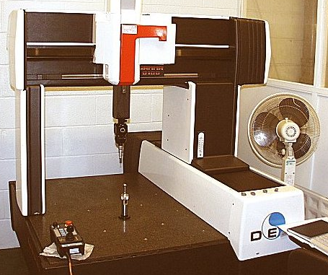
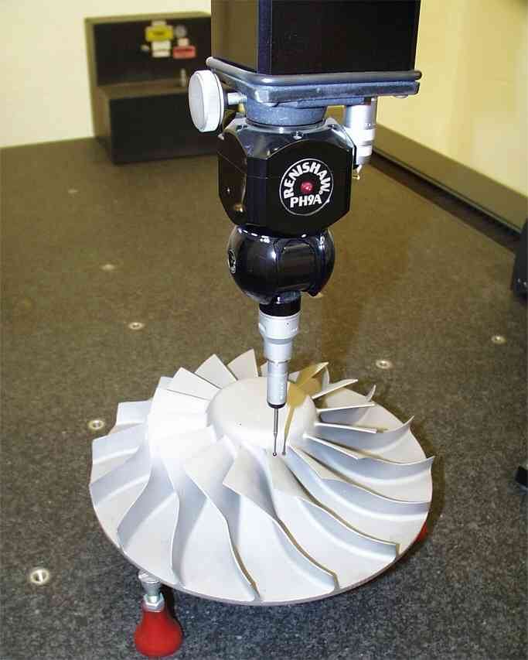
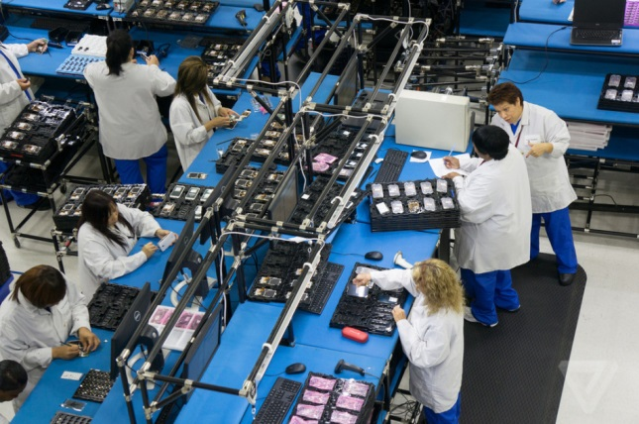
G. Tolerance Specifications and Inspection
Tolerance specification
Inspection
Mathematization of tolerance notions
Tolerance verification
Vision inspection
…

Slide 11
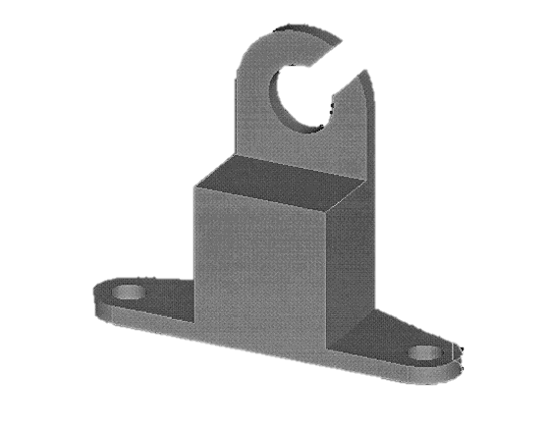
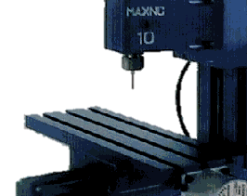
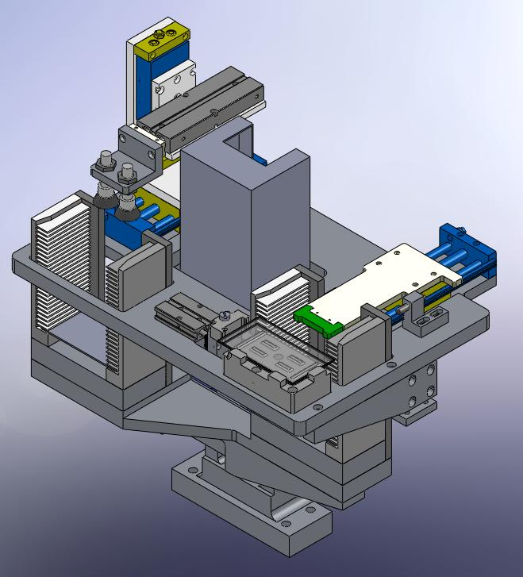



H. Workpiece Localization & Robot Calibration
CAD model
Computer aided setup
Workpiece localization of
Regular workpiece
Symmetric workpiece
Partially machined workpiece
Robot calibration

Slide 12
2. Geometers and “Geometric” Engineers

Slide 13
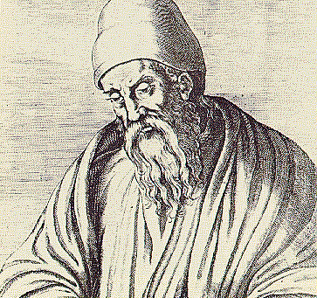
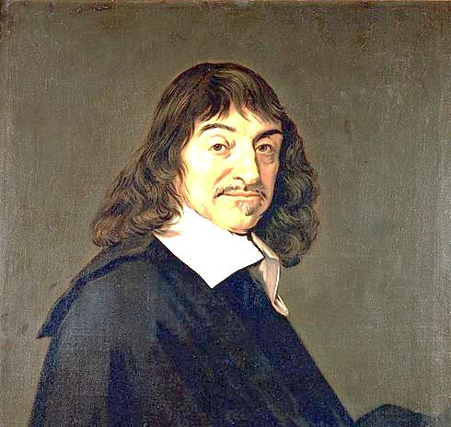
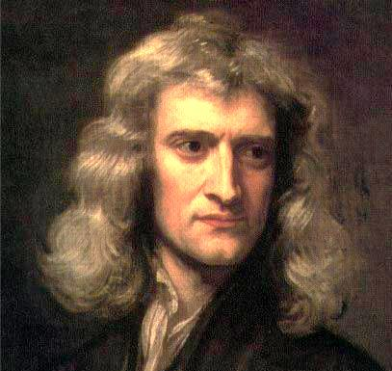
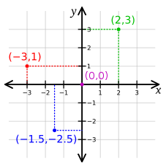
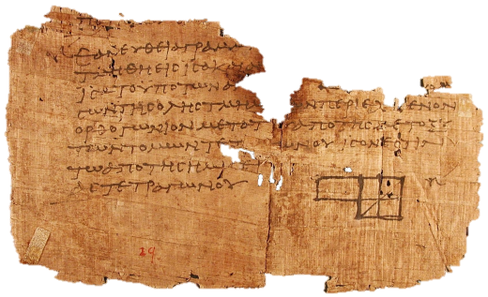

A. Euclidean Geometry and Calculus on $ℝ^{n}$
Euclid (325 – 265BC)
Descartes (1596 – 1650)
I. Newton (1642 -1727)
The Elements

Slide 14
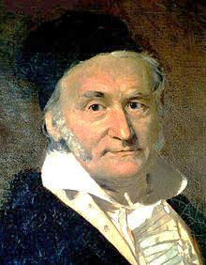
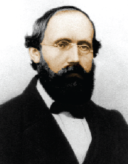
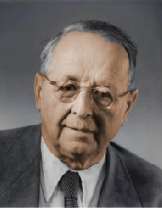
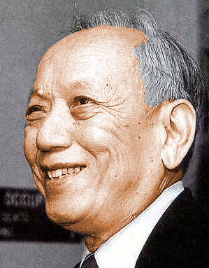

B. Non-Euclidean Geometry
C.F. Gauss
(1777 - 1855)
B. Riemann
(1826 - 1866)
H. Weyl
(1885 - 1955)
S.S. Chern
(1911 - 2004)
M.P.d. Carmo, Differential Geometry of Curves and Surfaces. Englewood Cliffs, N.J.: Prentice-Hall, 1976.
W.M. Boothby, An Introduction to Differentiable Manifolds and Riemannian Geometry. Amsterdam; London: Academic, 2002.
J.E. Marsden and T. S. Ra̦tiu, Introduction to Mechanics and Symmetry: A Basic Exposition of Classical Mechanical Systems. New York; Hong Kong: Springer, 1999.

Slide 15
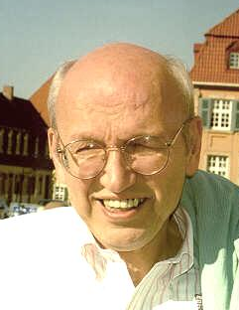
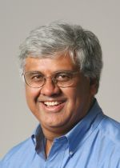
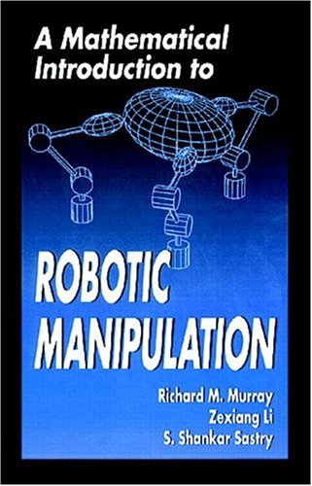
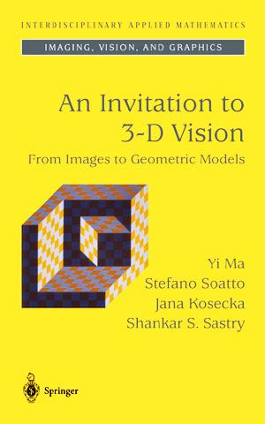
C. “Geometric” Engineers
R. Brockett
S.S. Sastry
D.J. Montana. Tactile Sensing and the Kinematics of Contact, Ph.D. Thesis, Harvard University, 1986.
F.C. Park, The Optimal Kinematic Design of Mechanisms, Ph.D. Thesis, Harvard University, 1991.
B. Paden. Kinematics and Control of Robot Manipulators, Ph.D. Thesis, EECS Department, University of California, Berkeley, 1986.
R. Murray (CDS, Caltech)
V.J. Kumar (GRASP LAB, Upenn)

Slide 16
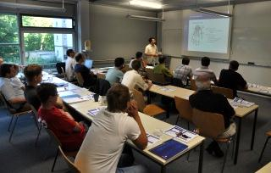
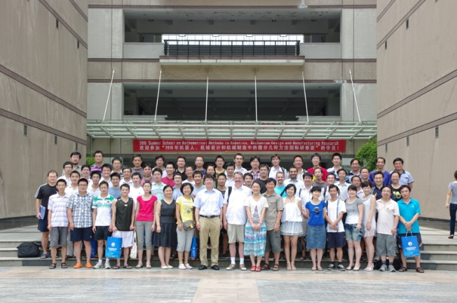
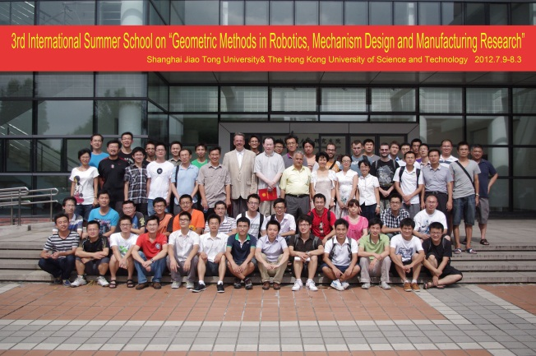
D. Further Information
International Summer school on Geometric Methods in Robotics, Mechanism Design and Manufacturing Research
J. M. Selig, Geometric Fundamentals of Robotics. 2nd ed., Springer, New York, 2005.
Z.X. Li, Y.Q. Wu, Lecture notes for “A Mathematical Introduction to Robotic Manipulation”, Online available, http://atc.ust .hk/~sum merschool2012
TUB, DE 2009
HUST, China 2010
SJTU, China 2012

Slide 17
3. The Unifying Tool: Differentiable Manifolds and Lie Group Theory

Slide 18
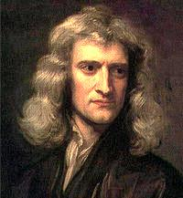
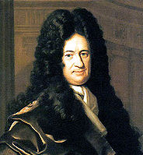
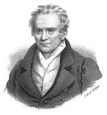


3.1 Calculus on $ℝ^{n}$ (1685)
Application of calculus in Engineering:
Newton (1643-1727)
Leibniz (1646-1716)
Simplification/
approximation
Engineering
Problems
Problems on $ℝ^{n}$
G. Monge (1794,
Ecole Polytechnic)

Slide 19






3.1 Calculus on $ℝ^{n}$ (1685)
Properties of $ℝ^{n}$:
A global single coordinate system:
Linear structure
$$α_{1}v_{1}+α_{2}v_{2}∈ℝ^{n}, ∀ v_{i}∈ℝ^{n}, α_{i}∈ℝ$$
Parallel postulate (Euclid’s 5th postulate)
Curvature: $k=0$, metric: ${\left\|x\right\|}^{2}=x^{T}x$
Geodesic: a unique straight line
$$x=\left[\begin{matrix}x_{1} \\ ⋮ \\ x_{n}\end{matrix}\right], ∀ x∈ℝ^{n}$$
$$\sum_{i=1}^{3}{θ_{i}}=π$$
$$θ_{3}$$
$$θ_{1}$$
$$θ_{2}$$

Slide 20





Function minimization (differentiation)
Function minimization (differentation) on $ℝ^{n}$
$$f:ℝ^{n}→ℝ$$
Search for $x_{0}∈ℝ^{n}$ s.t. $df\left(x_{0}\right)=0$
Definiteness of Hessian $H_{f}$:
$$H_{f}={\left[\frac{∂^{2}f}{∂x_{i}∂x_{j}}\right]}_{x_{0}}∈ℝ^{n×n}, H_{f}\left\{\begin{matrix}>0 & min \\ <0 & max \\ indefinite & saddle\end{matrix}\right.$$
Directional derivative in $v∈ℝ^{n}$:
$$〈df\left(x_{0}\right),v〉={\left.\frac{d}{dt}\right|}_{t=0}f\left(x\left(t\right)\right):\left\{\begin{aligned}x\left(0\right)=x_{0} \\ \dot{x}\left(0\right)=v\end{aligned}\right.$$ $={\left.\frac{d}{dt}\right|}_{t=0}f\left(x_{0}+vt\right):$ property of $ℝ^{n}$
Integration: …
$$ℝ$$

Slide 21






3.2 Differentiable Manifolds
A curved space in $ℝ^{n}$ (a model of beauty, Gauss 1828)
Hyperbolic Geometry $∑θ_{i}<π$
Elliptic Geometry $∑θ_{i}>π$

Slide 22























a) Definition (Riemann 1854)
$$U_{1}∩U_{2}$$
$$U_{1}=S^{2}−M$$
$$U_{2}=S^{2}−M′$$
$$id$$
$$φ_{2}^{−1}\left(v_{1},v_{2}\right)=\left[\begin{matrix}−cos{v_{1}}\cos{v_{2}} \\ \sin{v_{2}} \\ \sin{v_{1}}\cos{v_{2}}\end{matrix}\right]$$
$$φ_{1}^{−1}\left(u_{1},u_{2}\right)=\left[\begin{matrix}\cos{u_{1}}\cos{u_{2}} \\ \sin{u_{1}}\cos{u_{2}} \\ \sin{u_{2}}\end{matrix}\right]$$
$$φ_{1}$$
$$φ_{1}$$
$$φ_{2}$$
$$φ_{2}$$
$$φ_{2}∘φ_{1}^{−1}$$
$$V_{1}=φ_{1}(U_{1})$$
$$V_{2}=φ_{2}(U_{2})$$
$$φ_{1}(U_{1}∩U_{2})$$
$$φ_{2}(U_{1}∩U_{2})$$
a) Definition (Riemann 1854):
Note:
(1): $S^{2}=\bigcup_{i}{U_{i}}$
(2): $φ_{2}∘φ_{1}^{−1}:\left[\begin{matrix}u_{1} \\ u_{2}\end{matrix}\right]↦\left[\begin{matrix}v_{1} \\ v_{2}\end{matrix}\right]≔\left[\begin{matrix}f_{1}\left(u_{1},u_{2}\right) \\ f_{2}\left(u_{1},u_{2}\right)\end{matrix}\right]=\left[\begin{matrix}\sin^{−1}\left(\cos{u_{1}}\cos{u_{2}}\right) \\ \tan^{−1}{\frac{\sin{u_{2}}}{\sin{u_{1}}\cos{u_{2}}}}\end{matrix}\right]$
is a local diffeomorphism.

Slide 23

a) Definition (Riemann 1854)
$$id$$
$S^{2}=∪_{i=1}^{2}U_{i}$
$φ_{2}∘φ_{1}^{−1}:φ_{1}\left(U_{1}∩U_{2}\right)→φ_{2}\left(U_{1}∩U_{2}\right)$
$\left(u_{1},u_{2}\right)→\left(\sin^{−1}{(\sin{u_{1}}\cos{u_{2}}}),\sin^{−1}\left(\frac{\sin{u_{2}}}{{\left(1−\sin^{2}{u_{1}}\cos^{2}{u_{2}}\right)}^{\frac{1}{2}}}\right)\right)$
is a diffeomorphism.
$$φ_{1}$$
$$φ_{2}$$
$$φ_{2}∘φ_{1}^{−1}$$
a) Definition (Riemann 1854):
Note:
(1): $S^{2}=\bigcup_{i}{U_{i}}$
(2): $φ_{2}∘φ_{1}^{−1}:\left[\begin{matrix}u_{1} \\ u_{2}\end{matrix}\right]↦\left[\begin{matrix}v_{1} \\ v_{2}\end{matrix}\right]≔\left[\begin{matrix}f_{1}\left(u_{1},u_{2}\right) \\ f_{2}\left(u_{1},u_{2}\right)\end{matrix}\right]=\left[\begin{matrix}\sin^{−1}\left(\cos{u_{1}}\cos{u_{2}}\right) \\ \tan^{−1}{\frac{\sin{u_{2}}}{\sin{u_{1}}\cos{u_{2}}}}\end{matrix}\right]$
is a local diffeomorphism.

Slide 24











b) Examples
$ℝ^{n}≔\underset{n}{\underbrace{ℝ×⋯×ℝ}}$ is a $n$ dim manifold
$Γ^{2}≔S^{1}×S^{1}$ is a 2 dim manifold.
$Γ^{6}≔\underset{6}{\underbrace{S^{1}×⋯×S^{1}}}$ is a 6 dim manifold.
$$z$$
$$θ_{1}$$
$$b$$
$$x$$
$$a$$
$$y$$
$$θ_{2}$$

Slide 25






b) Examples
$ℝP^{1}$is a 1 dim manifold.
$ℝP^{2}$is a 2 dim manifold.
$$ℝP^{1}$$
$$S^{1}$$
$$ℝP^{1}$$
$$ℝP^{2}$$
$$S^{2}$$

Slide 26







c) Lie group (S. Lie, 1893)
Example:
$$R=\left[x′,y′,z′\right]∈ℝ^{3×3}$$
$$SO\left(3\right):=\{R∈ℝ^{3×3}|R^{T}R=I,\det{R}=1\}$$
$SO(3)$ also has group structure:
$∀ R_{1},R_{2}∈SO\left(3\right), R_{1}⋅R_{2}∈SO\left(3\right)$
$∃!e∈SO\left(3\right) s.t. e⋅R=R⋅e=R \left(e=I\right)$
$∀R∈SO\left(3\right), ∃!R^{−1}∈SO\left(3\right) s.t.$
$$R^{−1}⋅R=I, \left(R^{−1}=R^{T}\right)$$
$∀R_{1},R_{2},R_{3}∈SO\left(3\right),$
$$R_{1}⋅\left(R_{2}⋅R_{3}\right)=\left(R_{1}⋅R_{2}\right)⋅R_{3}$$
$$y′$$
$$z′$$
$$x′$$
Lie group=group + manifold

Slide 27






d) Other examples
$GL\left(n,ℝ\right)=\{A∈ℝ^{n×n}|\det{A≠0} \}$
$SE\left(3\right)=\left\{\left[\begin{matrix}R & p \\ 0 & 1\end{matrix}\right] | R∈SO\left(3\right), p∈ℝ^{3}\right\}$
$$R$$
$$B$$
$$p$$
$$A$$

Slide 28






Lie groups, Lie algebras and the exponential maps
Lie algebra:
$𝔤:=T_{e}G$
$G=SO(3)$
$so\left(3\right):=\left\{\left.\hat{ω}=\left[\begin{matrix}0 & −ω_{3} & ω_{2} \\ ω_{3} & 0 & −ω_{1} \\ −ω_{2} & ω_{1} & 0\end{matrix}\right]\right|ω∈ℝ^{3}\right\}$
$G=SE(3)$
$se\left(3\right):=\left\{\hat{ξ}=\left.\left[\begin{matrix}\hat{ω} & v \\ 0 & 0\end{matrix}\right]∈ℝ^{4×4}\right|ω,v∈ℝ^{3}\right\}$
$$e$$
$$𝔤$$
$$\hat{ξ}$$
$$G$$

Slide 29





Lie groups, Lie algebras and the exponential maps
Exponential map:
$exp:𝔤→G$
$G=SO(3)$
$so\left(3\right)→SO\left(3\right):\hat{ω}→e^{\hat{ω}}$
$G=SE(3)$
$se\left(3\right)→SE\left(3\right):\hat{ξ}→e^{\hat{ξ}}$
$$e$$
$$𝔤$$
$$\hat{ξ}$$
$$exp$$
$$e^{\hat{ξ}}$$
$$G$$

Slide 30











e) Subgroups of a Lie group:
Revolute joint:
$$S^{1}=\left\{e^{\hat{ξ}θ}|θ∈ℝ\right\}⊂SE\left(3\right) \\ \hat{ξ}=\left[\begin{matrix}\hat{ω} & q×ω \\ 0 & 0\end{matrix}\right]$$
Reuleaux lower pairs:
$$ω$$
$${\hat{e}}_{6}$$
$${\hat{e}}_{3}$$
$$q$$
$${\hat{e}}_{5}$$
$${\hat{e}}_{1}$$
$${\hat{e}}_{2}$$
$${\hat{e}}_{4}$$
Revolute Prismatic Helical Cylindrical Planar Spherical
$S^{1}$ $ℝ$ $H$ $ℝ×S^{1}$ $ℝ^{2}⋊S^{1}$ $SO(3)$

Slide 31





















f) Submanifolds of a Lie group
$M_{2}≔\left\{e^{\hat{x}θ_{1}}⋅e^{\hat{y}θ_{2}} | θ_{1},θ_{2}∈\left[0,2π\right)\right\}⊂SO\left(3\right)$
$M_{1}≔\left\{e^{\hat{x}θ_{1}+\hat{y}θ_{2}} | θ_{1},θ_{2}∈\left[0,2π\right)\right\}⊂SO\left(3\right)$
$$z$$
$$θ_{2}$$
$$θ_{1}$$
$$θ_{1}$$
$$b$$
$$x$$
$$a$$
$$y$$
$$θ_{1}$$
$$θ_{2}$$
$$θ_{2}$$
$$M_{2}≅Γ^{2}$$
$$y$$
$$ℝP^{2}$$
$$x$$
$$S^{2}$$
$$\underset{←}{2 to 1}$$
Eye movement
$$M_{1}≅ℝP^{2}$$
Five axis machining
$$S^{2}≅SO(3)/S^{1}$$

Slide 32




f) Submanifolds of a Lie group
Exponential submanifolds:$\exp{(V)}$
$$V$$

Slide 33






Engineering classification of differentiable manifolds
$$M$$
$$…$$
$$ℝ^{n}$$
$$G$$
$$G/H$$
$$\left(M,〈〈,〉〉\right)$$
Euclidean
space
Lie group
Homogeneous
space
Riemannian
manifold

Slide 34



g) Riemannian manifolds $(M,〈〈,〉〉)$ (Riemann 1854)
$$e_{1}=φ_{1∗}^{−1}\left.\left(\frac{∂}{∂u_{1}}\right.\right),e_{2}=φ_{2∗}^{−1}\left.\left(\frac{∂}{∂u_{2}}\right.\right) \\ g_{ij}={〈e_{i},e_{j}〉}_{ℝ^{3}}=e_{i}^{T}e_{j} \\ v=\sum_{i=1}^{2}{a_{i}e_{i}},w=\sum_{j=1}^{2}{b_{j}e_{j}} \\ {〈,〉}_{S^{2}}:T_{p}S^{2}×T_{p}S^{2}→ℝ \\ 〈v,w〉→{〈v,w〉}_{S^{2}}=\sum_{i,j=1}^{2}{a_{i}b_{j}g_{ij}}=a^{T}gb$$
$(S^{2},{〈,〉}_{S^{2}})$: Riemannian manifold
Distance: $s=\int_{0}^{T}{〈\dot{r}\left(t\right),\dot{r}\left(t\right)〉}dt$
Riemannian connection: $∇_{Z}〈X,Y〉=〈∇_{Z}X,Y〉+〈X,∇_{Z}Y〉$
Parallel transport: $∇_{\dot{γ}(t)}X=0, ∀t∈I$
Geodesics: $∇_{\dot{γ}\left(t\right)}\dot{γ}\left(t\right)=0, ∀t∈I⇒$ Arcs of great circle

Slide 35



g1) Geometric Control of Robot Manipulators
$$〈〈\dot{θ},\dot{θ}〉〉={\dot{θ}}^{T}M\left(θ\right)\dot{θ}=2T\left(θ,\dot{θ}\right) \\ M\left(θ\right)∇_{\dot{θ}}\dot{θ}=τ⇔M\left(θ\right)\ddot{θ}+C(θ,\dot{θ} )=τ$$
[1] J. Marsden and T. Ratiu, Introduction to Mechanics and Symmetry, Springer, 1996.
$$Γ^{6}=\underset{6}{\underbrace{S^{1}×⋯×S^{1}}}$$

Slide 36


g2) Newton-Euler Equations
$$T=\frac{1}{2}V^{T}MV=\frac{1}{2}{〈〈V,V〉〉}_{M} \hat{V}=g^{−1}\dot{g}$$
$$\begin{matrix}m\ddot{p} \\ I\dot{ω}+ω×Iω\end{matrix}\begin{matrix}= \\ =\end{matrix}\begin{matrix}f \\ τ\end{matrix}⇔M∇_{V}V=F⇔M\dot{V}−ad_{V}^{T}MV=F$$
Coordinate Invariant!
[2] Ploen, S.R. and Park, F.C. "Coordinate-invariant algorithms for robot dynamics," Robotics and Automation, IEEE Transactions on , vol.15, no.6, pp.1130-1135, Dec 1999.
$$g\left(t\right)∈SE(3)$$

Slide 37



g3) Position/Force control of constrained manipulators
Constraints: $f:Γ^{6}→ℝ^{m}$ or $A\left(θ\right)\dot{θ}=0$
Configuration space: $Q=f^{−1}(0)$
Free velocity: $T_{θ}Q$
Orth. complement:
$$T_{θ}Q^{⊥}=\left\{v∈T_{θ}^{}Γ^{6}|{〈v,w〉}_{Γ^{6}}=0, ∀w∈T_{θ}Q\right\}$$
Constraint wrench:
$$T_{θ}^{∗}Q^{⊥}=\left\{{f∈T}_{θ}^{∗}E|〈f,v〉=0, ∀ v∈T_{θ}Q\right\} \\ T_{θ}^{∗}Q=\left\{f∈T_{θ}^{∗}E|〈f,v〉=0, ∀ v∈T_{θ}Q^{⊥}\right\}$$
Decomposition:
$T_{θ}Γ^{6}=T_{θ}Q⊕T_{θ}Q^{⊥}$ $T_{θ}^{∗}Γ^{6}=T_{θ}^{∗}Q⊕T_{θ}^{∗}Q^{⊥}$

Slide 38

g3) Position/Force control of constrained manipulators
Euler-Lagrange Equations with Constraints:
$$\frac{d}{dt}\left(\frac{∂T}{∂\dot{θ}}\right)−\frac{∂T}{∂θ}=τ+A^{T}λ⇔M∇_{\dot{θ}}\dot{θ}=τ+A^{T}λ$$
$∇$: Riemannian connection of $M$
$\tilde{∇}$: Induced connection on $Q$
$$∇_{X}Y={\tilde{∇}}_{X}Y+\underbrace{S\left(X,Y\right)}$$
2nd fundamental form (curvature form)
Decoupled equations:
$$M{\tilde{∇}}_{\dot{θ}}\dot{θ}=P_{ω}τ \\ MS\left(\dot{θ},\dot{θ}\right)=\left(I−P_{ω}\right)τ+A^{T}λ$$
[2] J. M. Selig, Curvature in force/position control, ICRA’98, pp.1761-1766.
[3] G.F. Liu and Z.X. Li, A unified geometric approach to modeling and control of constrained mechanical systems. IEEE TRA 2002, pp.574-587.
Remark:
Stable hybrid control follows naturally
Gauge invariant
No need for an Euclidean metric

Slide 39





g4) Multi-fingered grasp and manipulations
Grasp map:
$$G⋅x=F$$
$x={\left(x_{1},…, x_{k}\right)}^{T}, x_{i}∈FC_{i}$.
$$FC_{i}=\left\{x_{i}∈ℝ^{3}|\sqrt{x_{i1}^{2}+x_{i2}^{2}}≤μ_{i}x_{i3}\right\}$$
HKUST Hand
$$x_{i}$$
$$x_{i}∈FC_{i}⇔P_{i}=\left[\begin{matrix}μ_{i}x_{i3} & 0 & x_{i1} \\ 0 & μ_{i}x_{i3} & x_{i2} \\ x_{i1} & x_{i2} & μ_{i}x_{i3}\end{matrix}\right]>0$$
$$x={\left(x_{1},…,x_{k}\right)}^{T}∈FC⇔diag\left(P_{1},…,P_{k}\right)∈S_{++}^{n}$$
$$FC_{i}$$

Slide 40



g4) Multi-fingered grasp and manipulations
$$S_{++}^{n}=\left\{P∈ℝ^{n×n}|P^{T}=P, P>0\right\} \\ 〈〈S_{1},S_{2}〉〉=Tr\left(S_{1}^{T}S_{2}\right), { S}_{1},S_{2}∈S^{n}=T_{P}S_{++}^{n}$$
$$Φ:S_{++}^{n}→ℝ:P→Tr\left(CP\right)+log det P^{−1}$$
P1: $\arg{\min{Φ(P)}}, P∈S_{++}^{n}$ $s.t. P>0, Tr\left(B_{i}P\right)=f_{ci}, i=1,…,6.$
Euclidean gradient:
$$∇_{T}Φ\left(P\right)=C−P^{−1}−Σ_{i=1}^{6}γ_{i}B_{i} \\ γ_{i}=Tr\left(B_{i}\left(C−P^{−1}\right)\right)$$
[1] M. Buss, L. Faybusovich, and J. Moore, “Dikin-type algorithms for dextrous grasping force optimization” International Journal of Robotics Research, 17(8): 831-839, 1998 .
[2] L. Han, J. Trinkle, and Z.X. Li, “Grasp analysis as linear matrix inequality problems.”in IEEE Tran. On Robotics and Automation, 16(6): 663-674, 2000.
[3] G.F. Liu and Z.X. Li, “Real-time Grasping Force Optimization for Multifingered Manipulation: Theory and Experiments”, IEEE/ASME Trans. On Mechatronics, 2002

Slide 41


h1) Geometric approach to robot kinematics
Open-chain manipulators
$$g\left(θ\right)=e^{{\hat{ξ}}_{1}θ_{1}}e^{{\hat{ξ}}_{2}θ_{2}}⋯e^{{\hat{ξ}}_{6}θ_{6}}$$
Jacobian $\left[\begin{matrix}v \\ w\end{matrix}\right]=J\left(θ\right)\dot{θ}$
$$J\left(θ\right)=\left[\begin{matrix}ξ_{1}^{′} & ξ_{2}^{′} & ⋯ & ξ_{6}^{′}\end{matrix}\right]$$
Inverse kinematics via Paden-Kahan
subproblems
Optimal workspace design
[1] R. Brocket, Robotic manipulators and the product of exponentials formula, In P.A. Fuhrman, editor, Mathematical Theory of Networks and Systems, pages 120-129. Springer-Verlag, 1984.
[2] B. Paden and S. Sastry, Optimal kinematic design of 6R manipulators. International Journal of Robotics Research, 7(2):43-61,1988.
[3] R. Murray, Z.X. Li, and S. Sastry, A Mathematical Introduction to Robotic Manipulation. CRC Press, 1994.

Slide 42



h2) Coordinate invariant algorithms of open chain manipulators
Forward recursion:
$$V_{0}=0, {\dot{V}}_{0}=\left[\begin{matrix}g \\ 0\end{matrix}\right] \\ g_{i−1,i}=g_{i−1,i}\left(0\right)e^{{\hat{ξ}}_{i}θ_{i}} \\ V_{i}=Ad_{g_{i−1,i}^{−1}}V_{i−1}+ξ_{i}{\dot{θ}}_{i} \\ {\dot{V}}_{i}=ξ_{i}{\ddot{θ}}_{i}+Ad_{g_{i−1,i}^{−1}}{\dot{V}}_{i−1}−ad_{ξ_{i}}\left(Ad_{g_{i−1,i}^{−1}}V_{i−1}\right)$$
Backward Recursion:
$$F_{i}=Ad_{g_{i,i+1}^{−1}}F_{i+1}+M_{i}{\dot{V}}_{i}−ad_{V_{i}}^{T}M_{i}V_{i} \\ τ_{i}=ξ_{i}^{T}F_{i}$$
$$M\left(θ\right)\ddot{θ}+C\left(θ,\dot{θ}\right)\dot{θ}+N\left(θ\right)=τ$$
O(n) algorithm
Geometric
Factorization of $M\left(θ\right)=ξ^{T}G^{T}MGξ⇒$
Adaptive control, system identification Hybrid control…
[1] S. Ploen & F. Park, Coordinate-invariant algorithms for robot dynamics, IEEE TRA 1999, pp. 1130-1135.

Slide 43




h3) Nonholonomic motion planning of a falling cat
Configuration space: $q=\left(A_{1},A_{2}\right)∈SO\left(3\right)×SO(3)$
Angular momentum: $μ=\left(A_{1}J_{1}+A_{2}J_{12}^{T}\right)w_{1}+\left(A_{2}J_{2}+A_{1}J_{12}\right)w_{2},$
${\hat{w}}_{i}=A_{i}^{T}{\dot{A}}_{i}, i=1,2$ $A=A_{1}^{T}A_{2}:$ shape $\hat{u}=A^{T}\dot{A}:$ control
System equations: $\dot{q}=b_{1}\left(q\right)u_{1}+b_{2}\left(q\right)u_{2}+b_{3}\left(q\right)u_{3}$
Controllability condition: $span\left\{b_{1},b_{2},b_{3},\left[b_{i},b_{j}\right],…\right\}=6$
[1] C. Fernandes, L. Gurvits and Z.X. Li, Near-optimal nonholonomic motion planning for a system of coupled rigid bodies", IEEE Trans. on Automatic Control, Vol. 39, pp.450-463, March, 1994.

Slide 44













i) Homogeneous Spaces
$G$: A Lie group, $H⊂G$
$∀g_{1},g_{2}∈G,$
$g_{1}∼g_{2}$ iff $g_{1}^{−1}g_{2}∈H$
$\left[g\right]≔gH$
Homogeneous space:
$$G/H≔\left\{\left[g\right]|∀g∈G\right\}$$
a manifold of dimension $\dim{G}−\dim{H}$.
$$e$$
$$g_{2}$$
$$g_{1}$$
$$H$$
$$g_{1}H$$
$$G$$
$$G/H$$
$$\left[e\right]$$
$$\left[g_{1}\right]$$
Configuration space of an infinite cylinder
$$G=SE\left(3\right), H=\left\{e^{\hat{ξ}θ} | θ∈ℝ\right\} \\ \dim{G/H}=6−1=5$$
$$ξ$$

Slide 45












i1) Symmetric workpiece localization
P: Localize a workpiece with measurement data ${\left\{y_{i}\right\}}_{I}$:
$$\underset{g∈SE\left(3\right),x_{i}∈S_{i}}{arg min}{∑{\left|\left|gx_{i}−y_{i}\right|\right|}^{2}}$$
Symmetric workpiece localization:
$$\underset{\begin{aligned}g∈SE(3)/H \\ x_{i}∈S_{i}\end{aligned}}{arg min}{∑{\left|\left|gx_{i}−y_{i}\right|\right|}^{2}}$$
$${\left\{y_{i}\right\}}_{I}$$
$$C_{M}$$
$$g$$
$$C_{W}$$
$$C_{M}$$
$$S_{i}$$
$${\left\{x_{i}\right\}}_{I}$$

Slide 46
















i2) Task space of five-axes machining
$$S^{1}$$
$$S^{1}$$
$$R_{2}$$
$$R_{1}$$
$$R_{0}$$
$$R_{3}$$
$$R_{0}$$
$$R_{1}$$
$$R_{2}$$
$$R_{3}$$
Fix $z∈S^{2}$, define:
$$ψ:SO\left(3\right)↦S^{2},R↦R⋅z$$
$$ψ^{−1}\left(z\right)=\left\{e^{\hat{z}θ} | θ∈\left[0,2π\right)\right\}≅S^{1}$$
$$SO(3)$$
Linear algebra fact:
Given $A:V↦W$,
$$R\left(A\right)≅V/\ker{A}$$
$$e^{\hat{z}θ}∈S^{1}$$
$$S^{2}≅SO(3)/S^{1}$$
Similarly:
$$S^{2}≅SO(3)/S^{1}$$
is the task space of five-face machining
$$z$$

Slide 47


i3) Tolerance formulation and verification
Tolerance specification
Inspection

Slide 48

i3) Tolerance formulation and verification
ANSI Y14.5 Standard
Form, profile $−$5 cases
Flatness
Straightness
Cylindricity
Circularity
Profile
Orientation $−$ 3 cases
Planar orientation
Cylindrical orientation
Linear orientation
Location $→$ 52 cases
Runout $−$ 4 cases
Problems:
graphic expression;
case by case basis.
effic. but inconsist. LSA
ANSI Y14.5.1M
partially addressed
those problems but
not completely.
Differential geometry tools
Unified formulation; (simple and compact)
Efficient verification.

Slide 49


i3) Tolerance formulation and verification
Symmetry subgroups and configuration spaces of symmetric features
Feature | Symbols | Isotropy $G_{0}$ | Config. Space $Q$ | Description | Dim
Circle in $E^{2}$ |  | $$SO(2)$$ | $${SE\left(2\right)}/{G_{0}}=T(2 )$$ | Rotation around the center of circle | 2
Straight line in $E^{2}$ |  | $$T(1)$$ | $${SE\left(2\right)}/{G_{0}}=T(2 )$$ | Translation along the line | 2
Sphere |  | $$SO(3)$$ | $${SE\left(3\right)}/{G_{0}}=T(3)$$ | Rotation about the center of sphere | 3
Plane |  | $$SE(2)$$ | $${SE\left(3\right)}/{G_{0}}$$ | Rotation about the normal & translation in the plane | 3
Straight line in $E^{3}$ |  | $$SO\left(2\right)×T(1)$$ | $${SE\left(3\right)}/{G_{0}}$$ | Rotation about and translation along the line | 4
Cylinder |  | $$SO\left(2\right)×T(1)$$ | $${SE\left(3\right)}/{G_{0}}$$ | Rotation about and translation along the axis | 4
Cone (revolved surface) |  | $$SO(2)$$ | $${SE\left(3\right)}/{G_{0}}$$ | Rotation about the axis of cone | 5
Tabular Surface |  | $$T(1)$$ | $${SE\left(3\right)}/{G_{0}}$$ | Translation along the sweeping direction | 5
Sculptured surface without symmetry |  | $$I$$ | $$SE(3)$$ | Identity element | 6

Slide 50


i3) Tolerance formulation and verification
Flatness
P: Given $Y={\left\{y_{i}\right\}}_{I}$, CAD model, find $g∈$ $SE\left(3\right)/G_{0}$ s.t.
$t=\min_{g∈SE(3)/G_{0}}{(\underset{ }{\max_{y_{i}∈Y}}{d\left(g,y_{i}\right)−\min_{y_{i}∈Y} d(g,y_{i})})}$
[1] J.B. Gou, Y.X. Chu, Z.H. Xiong, and Z. Li, A geometric method for computation Of datum reference frames, IEEE TRA, 2000, pp. 797-806.
[2] J.B. Gou, Y.X. Chu, and Z.X. Li, A geometric theory of form, profile, and orientation tolerances. Precision Engineering, 1999, pp.79-93.

Slide 51











j) Parallel mechanism Synthesis
Subgroups of $SE(3)$
motion type $Q$
Leg motion type $M_{i}$
s.t. $Q⊂M_{i}, Q=∩_{i}M_{i}$
Submanifolds of $SE(3)$
$Q=SO(3)$
$$M_{i}=\left\{\begin{aligned}PL\left(ω_{j}\right)⋅SO(3) \\ S\left(N_{j}\right)⋅SO(3) \\ C\left(o,ω_{j}\right)⋅SO(3)\end{aligned}\right.$$

Slide 52
4. From Geometry to Startups

Slide 53




a) The first startup: Googol Technology (固高科技)
Dorm Porch Garage Park
(“Science as Inspiration” - L. Page, Google 2002)
Controller for HKUST Hand
ATC GM-400 for a tin plate cutter (1997)

Slide 54

a) The first startup: Googol Technology (固高科技)
order
Overseas
Labor
Land
Equipment
Product
Foxconn
Order
Overseas
Domestic
Labor
Land
Equipment
Product
Critical components
Technical support

Slide 55






a) The first startup: Googol Technology (固高科技)
Googol Headquarters
Googol HK (1999.7-~)
Googol Shenzhen
(1999.10- ~)
Googol Research
Institute (2011-~）
Googol Dong’guan （2012-~）
Googol Engineers

Slide 56











a) The first startup: Googol Technology (固高科技)
Motion Controllers
固高运控产品发展路线
发展运动控制核心技术；提供装备制造业控制平台；培养运动控制技术应用人才。
基于PC的插卡式运动控制器
基于PC的嵌入式运动控制器
基于PC的一体化运动控制器
CPAC-计算机可编程自动化控制器
GTS
GN
GE
GT
CPAC
GV
GU
GUC
Notes:
56

Slide 57

a) The first startup: Googol Technology (固高科技)
Market Share
Domestic market share of PC based Motion Controller 2011
- 2000-2011公司销售增长60倍，年平均增长率将近50%
- 运动控制器产品市场占有率从2007年的13%,到2011年超过了48%（珠三角达到70%）;
工业用户涉足40多个行业，1300多个厂家（约600家在珠三角）。
每月增加20多个新用户，用户不断提出新的技术要求

Slide 58
b) Reform the Curriculum
Re-examine our Curriculum
Capstone Design
Final Year Project
Language
for ECE
Total Requirements (inc. UCore) = 117 Credits
6 credits
3 credits
Pre Requisites (30 credits)
Science 6, Math 15, Intro 3, Programming 3, Language 3
Major Requirements (51 credits)
ECE Intro 8, Foundation 16, Area 12,
Depth 6, FYP 6, Language 3
Specialty
Depth I
Depth II
3 credits
3 credits
Area
Courses
3 out of 6 (3x4=12 credits)
Comm. &
Sig. Proc.
Systems &
Automation
Embedded
Systems
Integrated
Circuits
Semicond.
Materials &
Devices
E & M
Foundation
courses
Signals
& Systems
Digital Circuits
& Systems
Electronic
Circuits
Computer
Organization
4x4= 16 credits
Communication
for Engrs
ECE Intro (入门课程)
Science
(科学基础)
Math (数学基础)
3 credits each
Computer
Programming
Signal Processing/
Communications
Mechanics
& Heat
Calculus I
Linear
Algebra
ODE
Engr. Intro.
Course
Electro-Robot Design
E & M
and Light
Calculus II
Multi-var
Calculus
Probability
(ELEC 210)
2x4 = 8 credits
6 credits
6 credits
3 out of 4 (9 credits)

Slide 59

b) Reform the Curriculum
New Courses

Slide 60

b) Reform the Curriculum
New Courses

Slide 61












c) Another startup: DJI Innovation (www.dji.com)
DJI Founded in 2006
Milestone product 2008

Slide 62




大疆——The Future of Possible
3.4 DJI Innovation

Slide 63




大疆——社会效应

Slide 64


12333%
DJI VS 全美增长最快的高科技公司（2013）
7900%
5876%
536
4813%
356.5
196.7
248.1
984%
237.7
233.5
214.7
605%
534%
160.4
150
112.6
127.7
479%
385%
384%
324%
Living
Social
Silver
Spring
Networks
GSC
Packaging
Workday
Tableau
Software
Gogo
Burrow
Global
Scrap Metal
Services
Ruckus
Wireless
Audubon
Engineering
Company
DJI
3-year Growth
Revenue（millions）

Slide 65












d) More startups: Lie Group Automation
俞春华
石金博

Slide 66









粤港机器人产学研体系
广东省运动控制与先进装备国际创新团队
逸动科技

Slide 67
5. Opportunities and Challenges of a New Robotics Industry in China

Slide 68

5.1. Major Milestones of Industrial Robots
Growth of Global Auto Production
Karl Benz’s first automobile in 1885;
Ford Motor T-model & hard automation in 1908;
Production reached 8M in 1950.
Unimation’s first robot at GM plant;
US lead industrial robot & components industry (1961-1985)
Japan auto catches up
Japan lead industrial robots & components (1985-2013)
Fanuc, Yaskawa, Nabtesco, HD,…

Slide 69



2. A Grand New Opportunity for Industrial Robots
a) Auto & Traditional Market
Develop. of components (motors, drives, transmission, controller, etc.)
Machine tool production—U.S., Japan, Germany and China
China Industrial Robots Consumption (2005--2012)
Japan
(unit)
Import
Local
Billions of USD
China
05-12: GAGR 30%
Germany
05-12: GAGR 25%
United States
Robots/10K workers: China 145, Japan 1,450
Largest industrial robot market in 2014

Slide 70






5.2. A Grand New Opportunity for Industrial Robots
b) 3C Manufacturing Industry
3C Products
Small
Consumer
Appliance
LV Electrical
Equipment
Automotive
Electronics
Communication
Computer
Consumer
Smartphones
Feature phones
Telephones
Walkie-talkies
Desktop PC
Notebook PC
Tablets
Keyboards
Mouse
Servers
Modems
Memory
Gaming consoles
DVD players
Camera
Camcorder
Television
GPS devices
MP3 players
Wearable Products
Irons
Shavers
Toothbrushes
Coffee makers
Hand mixers
Hair dryers
Drills
Sensors
Tachometers
Switches
Circuit breaker
Car audio
Electrical Motors
Injections
Airbags
Locking systems
Semiconductors : wafers
FPD –LCD : Displays - screens
Components, Assemblies, Plug-and-socket connectors

Slide 71



























5.2 A Grand New Opportunity for Industrial Robots
b) 3C Manufacturing Industry
Casing manufacturing
Key components manufacturing
Molding
Glass
manufacturing
PCBA
Display & Touchscreen
Connectors
Grinding/
Polishing/
Anodizing/
Painting/
Laserwelding
Assembly/
Dispensing/
Screwdriving
Testing/
Packaging
Pressing/
Die Casting

Slide 72





5.2 A Grand New Opportunity for Industrial Robots
b) 3C Manufacturing Industry
Automobile Industry
16 million units/year
Workforce: 3-5 million
Robots/10k workers: 141 (Japan: 1584)
Requirement:
Standard precision: 100 micron
Large payload
Position Control
Major Suppliers:
ABB, KUKA, Yaskawa, FANUC
C³ Industry (communication/Computer /Consumer electronics )
Workforce: 20 million
Units:
mobile phone: 2 billion
Computer: 350 million
Consumer
Requirement:
High precision: 30 micron
Flexible parts
Small parts
Short cycle time Major Suppliers: ?

Slide 73

5.2 A Grand New Opportunity for Industrial Robots
China Robot growth Projection (2012-2022)
units
12-22 year: GAGR of 36%
600K
340K
12-22 year: GAGR of 23%

Slide 74












Silicon Valley vs Shengang Bay
Top 3 companies in Shenzhen (2011)
Company | Number of Employees | Sales/Person | Profit / profit Margin
Huawei | 144,000 | ￥203.9B/1.45M | ￥11.6 B/9.1%
Tencent | 17,000 | ￥28.4B/1.6M | ￥10.2 B/35%
Mindray | 6,800 | ￥5.4B/0.8M | ￥1.15 B/21%
٭ ٭ ٭ ٭ Hollywood of makers
Design Co.s (Visualization of ideas)
Shops & factories for prototypes & small batch prod.
Factories for large scale prod. (Apple, Samsung, Microsoft,…)
Components suppliers
Logistics components
Experienced workers & managers for your own factory
Top 10 companies in Silicon Valley (2012)
Unit : USD | Silicon Valley |  | Hong Kong | Shenzhen at large
Area | 4,700 km² |  | 1,100 km² | 4,400 km²
Population | 3 M |  | 7 M | 18 M
GDPP | 258 B*/86,000** |  | 243 B/34,000 | 178 B/17,000
Dongguan
Songshan Lake
Robotic Startup Center
Chang’an HDD (40%)
Rank | Company | 2012 Performance (100M USD) | Profit% | Number of Employees （person） | GDPP （10,000 USD）
1 | Apple | 1,646 | 25% | 72,800 | 226
2 | HP | 1,186 | -11% | 331,800 | 35.8
3 | Intel | 533 | 21% | 105,000 | 50.8
4 | Google | 513 | 21% | 53,861 | 95.3
5 | Cisco | 472 | 20% | 66,639 | 70.8
6 | Oracle | 371 | 28% | 115,000 | 32.3
7 | Ebay | 170 | 19% | 30,750 | 55.3
8 | Synnex | 102 | 1% | 11,615 | 87.8
9 | Gilead Sciences | 97 | 27% | 5,000 | 194
10 | Applied Materials | 81 | 0% | 14,776 | 54.8
 | Total | 5,171
*No. 37 in world
** 1.6 times of per capita in U.S.
Shenzhen
Shenzhen Technology park
Hong Kong
Hong Kong University
of Science and Technology
10KM

Slide 75














(a) Robotic Technology and its Impact:
Robotic Technology Modules (RTM)
1.Actuators
-Motors
DC
AC Brushless
-DD Motors
Drives
Smart drives
(Googol, Servotronics)
2.Transmission
-RV Reducer
( Nabtesco, 振康 )
-Harmonic Drive
(HD, 绿的)
-Other Transmission
Components
(NSK, THK, Hiwin, …)
3.Control
-Controller
(Googol, Keba)
-HMI
-Integrated Control
-MC Level Software
-Motion Planning
4.Sensing
-Force sensors
-Encoder(linear, rotary)
-Gyro(IMU)
-GPS
-Laser radar
5.Vision
-CMOS Sensors
-Optics
-Signal processing,
Compression &
Transmission
6. Softwares
-Robot Operating
System (ROS)
-App. Software
7.Communication
-Field Bus Technology
-Wireless transmission
8.SOC Chipsets
-MC Control Chipsets
-HD Video Transmission
Chipsets
9.Mechanisms
-Novae Parallel
Hybrid Mechanisms
-Structure / Topology
Optimization
-Co- Simulation
10.Power
-Battery management
-Charging technology
1. Robot Machines
CNC Machine Tools
Injection Molding Machines
Electronic Packaging Machines
Textile Machines
2. Industrial Robots
3.Medical / Healthcare Robotics
Home robots
Surgical robots
Rehabilitation robots……
4. Autonomous Systems
SLAM Technology
Sensor Function
-Self-Driving Cars
-AGV
-Mobile Manipulators
-UAV/UUV
5.Consumer Robotics
Fly Cameras/UAVs
Electric Outboard
System Integration
Tooling, fixture
Process, simulation

Slide 76
Strategy and Implementation
(a1): Robot Machines in China
Industry Name | 2012 Output Value in RMB （Source: Industrial Network） | Units
1. CNC Machine Tools | 721.1B | 800K
2. Electronics Manufacturing Equipment | 272.3B
3. Textile Machines | 116.3B
4. Packaging Machines | 22.2B | 72K
5. Foods, Beverages, Tobacco Machines | 18.4B
6. Rubber Machines | 24.9B
7. Plastic Machines | 46.2B | 270K
8. Printing Machines | 25.2B
9. Others: Wind power , lithium batteries, etc.
Total: | >1,244B (USD 207B)

Slide 77
Strategy and Implementation
(a3) Medical/Healthcare Robotics
(a4) Autonomous Systems
(a5) Consumer Robotics

Slide 78



The HKUST Robotics Institute
(b) Robotic Technology Powerhouse:
HKUST
SSCI
SENG
SBM
SHSS
ECE
HKUST Robotics Institute
Industry Partners
CSE
 | HKUST Robotics Institute
Faculty | 7-10 (7x)
Students | 100 (10x)
Staff | 10 (5X)
Space | 800 m² (7X)
MAE
RI Shenzhen Incubation Center
IELM
Entrepreneurship program center
Dongguan Songshan Lake Science Park

Slide 79
(c) Robotic Industry Incubation Center at Songshan Lake:
SSL Robotic Technology Development Co. Ltd
Robotic Technology Research Institute (RTRI)
Startup Projects
Robotic Incubation Center (RIC)
Entrepreneur’s Training Academy
Talents
Other Startups
Service Facilities:
Registration,Tax,
Legal , Intellectual Property
Management Consulting（R&D,
manufact, marketing , human
resources, supply chain , etc. ）
Angel, venture funds, IPO
Prototyping, production, quality
control, process control
Financial Services
Clear Water Bay Angel Fund
WKT
Walden/Sequoia (?)
Other Funds
Robotics Engineering
Master w/ HKUST
Entrepreneurial Leader
Training

Slide 80














The Robotics Startup Center at Songshan Lake
Googol, DJI, QKM
HKUST RI &
Other Representation
Googol’s Strategic Partners
(1,700+100 SI)
International Collaborators
(Univ.+Co.s)
Domestic Ind.
& Univ. Partners
RTM
Project team
Technology
1.Actuators
2.Transm.
Team+Idea+Fund
Individual
3.Control
4.Sensing
Robotic Technology Research
Institute (RTRI)
Other talents
RTM
Tech. develop
Fund support
Team develop
Talents
5.Vision
6. Software
RTM
Team building
Technology
Funding support
7.Comm.
8.SOC
Startup Teams
9.Mech.
10.Power
Startup
Robotic Incubation Center
Startup
1. Robot Machines
2. Industrial Robots
System Integration
3.Medical / Healthcare Robotics
4.Autonomous
Systems
5.Consumer Robotics

Slide 81
Thank you

